Slide 1
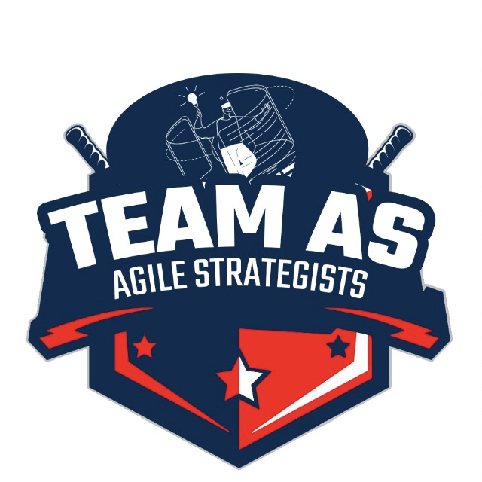
BCS -15
Delivering Daily Comfort at Your Doorstep - DND
Your Daily Needs, Our Priority!
IT & Business Analysis DEPARTMENT
Prepared by: Komal Kolte

Slide 2
Case Understanding – Daily Needs Delivery LLP (DND)
DND uses app-based ordering system where customers (in cities Bangalore, Delhi and Hyderabad) can order for their daily needs of milk products – milk, curd and paneer particularly ONLINE from the App.
App features currently:
1. Manage or subscribe for monthly deliveries in the app
2. Mark dates when they don't need delivery in the app
3. Wallet payment based on recharge using BHIM UPI
4. Refer services to friends and family
5. Delivery calendar visible in the app

Slide 3
Management Principle: Customer Centricity to drive the app adoption (hence sales)
Real-time Tracking and Notifications for deliveries
Streamline Refund and Complaint Resolution Process
Educational Resources for Customers to generate awareness about new features
Continuous Monitoring and Iteration based on data analytics of trends, areas for improvement, iterate the app
Customer Engagement and Communication to engage customers effectively
Investment in Customer Support to handle customers’ queries, feedback, and complaints
Quality Assurance Measures to ensure product freshness and integrity upon delivery
Feedback Mechanism Improvement to report missing deliveries, wrong products, or quality issues directly
Expansion Strategy with Data-driven Insights to initiate services in non-dense areas
Enhance User Experience (UX) for app’s usability based on data analytics
Areas
of
Improvement.

Slide 4
New features in-app to increase usability, customer delight & sales (1/2)
Real-time Tracking and Notifications for deliveries
1a. Integration with OSM Maps to give the delivery partners idea of the route and optimise the routing algorithm for minimum delivery time
1b. GPS tracking capabilities for customers can track real time the delivery just like in apps Zomato, Swiggy.
2. Streamline Refund and Complaint Resolution Process
2a. Implement QR code or OTP-based delivery verification
2b. Instant Refund triggered upon QA status confirmation for cancelled orders
5. Customer Engagement and Communication to engage customers effectively
5a. Push targeted notifications to customers every night with offers over products to modify their calendar for purchase
5b. Auto triggered SMS about any change in subscription plans or new announcement like offers
3. Educational Resources for Customers to generate awareness about new features
3a. Provide in-app tutorials, short videos to inform about new features just like how Whatsapp doing for new feature over Stories.

Slide 5
New features in-app to increase usability, customer delight & sales (2/2)
7. Quality Assurance Measures to ensure product freshness and integrity upon delivery
7a. A QA check button on the end user screen upon delivery and the option to refuse a delivery when QA check not passed.
7b. The QA check button will work on algorithm mandated by regulatory bodies like fssai for visual/touch based QA of milk products.
8. Feedback Mechanism Improvement to report missing deliveries, wrong products, or quality issues directly
8a. Introduce a feedback collection system through push notifications or short surveys before subsequent orders.
8b. Introduce FAQ document covering guidelines for common issues likely to happen like missing delivery etc. to reduce #complaints
9. Expansion Strategy with Data-driven Insights to initiate services in non-dense areas
9a. Introduce delivery of groceries on pre-order on pilot basis and then scale (diversify) as a separate section just like Swiggy Instamart
9b. Once revenue targets met from business optimization in 3 cities, expand model to more cities (geography expansion). An option on home screen to select ‘city’ to order
10. Enhance User Experience (UX) for app’s usability based on data analytics
10a. Integration with other payment options like Gpay, PhonePe, COD option besides wallet recharge.
10b. Working out a lite version of the application to operate in low internet connectivity.
10c. History of orders placed, visibility of issues raised current status and tracking via ticket-based system.

Slide 6
Key Performance Indicators for DND app
Sales Data: DND's sales data indicates strong growth, with considerable annual revenue. However, operational challenges are affecting the overall efficiency and profitability.
Measured by average value of order per customer, Cost per Acquisition (CAC) of new customer, Monthly Recurring Revenue (MRR) etc.
App Installations: Active and inactive app installations reflect both growth and a need for better user engagement strategies.
Measured by MAU, DAU (Monthly/Daily Active Users)
Customer Engagement: Reflects adoption of the app by its userbase. Measured by Stickiness (DAU/MAU), Churn rate (users leaving the app), Bounce rate (customers not completing the order cycle), # BHIM API calls for payments, # wallet recharges, wallet value per user, #deliveries completed etc.
Customer Satisfaction : Reflects the enhancements/refinements that can be done to app to improvise the overall app user journey.
Measured by CSAT rating (Customer SAtisfaction Test), customer feedback and complaints

Slide 7
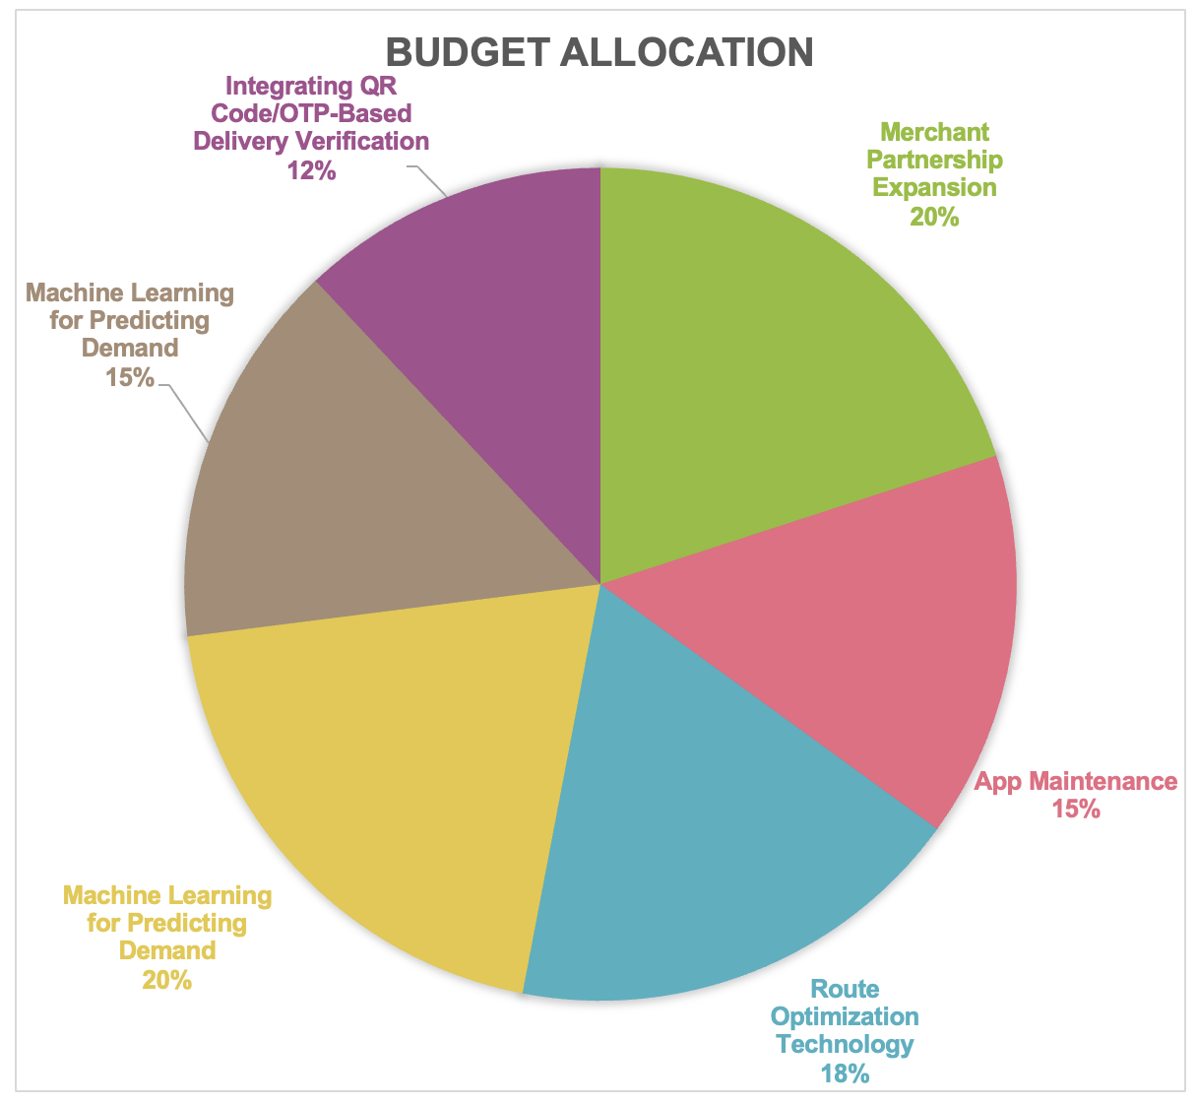
Budget for IT-BA department
Projects | Budget | % allocation (1 Cr = 100%)
Merchant Partnership Expansion | 20% | 20 Lakhs
App Maintenance | 15% | 15 Lakhs
Route Optimization Technology | 18% | 18 Lakhs
Machine Learning for Predicting Demand | 20% | 20 Lakhs
Association Algorithm for Recommendations and Bundling | 15% | 15 Lakhs
Integrating QR Code/OTP-Based Delivery Verification | 12% | 12 Lakhs

Slide 8
Growth strategy for next year
Besides the projects in pipeline for budget allocation, DND can consider:
1. Growth by diversification of product offerings:
Add complementary products to milk products like tea powder, baking powder or spices available for order
Add variants of curd, paneer, milk like Greek yogurt or soy milk or tofu etc. available for order
Add entire groceries for daily consumption available for order (excludes atta/rice etc.)
2. Growth by expansion to new geographies:
Delivery personnel network expansion over non dense areas with dark storage to facilitate faster deliveries (like Zepto business model) in short term. (Can include nearby cities to the existing cities to establish delivery and storage network for multi-city model, in long term)
3. Growth by onboarding more suppliers to cater to increasing demand:
Building an application for delivery partners as well as milk products suppliers to update the delivery status from their end and inventory management for DND staff based on inputs from suppliers.

Slide 9
Thankyou
By: Komal
Team Agile Strategists

